Slide 1


Consultation Site for Healthcare
Group Members:
1.Ajim Sanadi(250245920075)
2.Amol Borse(250245920012)
3.Devyani Zode(250245920022)
4.Nida Kazi(250245920038)
5.Sanket Zambare(250245920099)

Slide 2

Introduction
The Online Healthcare Consultation System is a web-based platform designed to simplify and digitize the interaction between patients and doctors. In today’s fast-paced world, accessing timely healthcare can be challenging due to distance, busy schedules. This system aims to solve those issues by allowing patients to book appointments, consult doctors, and receive digital prescriptions from the comfort of their homes.
The system supports three main types of users:
Patients: who can register, search for doctors, and book appointments.
Doctors: who can manage their availability, consult patients, and provide prescriptions.
Admins: who monitor the overall system and manage users and appointments.

Slide 3
Problem Faced By People
Access to quality healthcare is limited in rural areas.
Urban hospitals are often overcrowded with long waiting times.
Scheduling and attending doctor appointments physically challenging due to travel issues.
Many people are unaware of specialist doctor to consult for their condition.

Slide 4





Solution
Online Doctor Access for Villages
No Long Queues
Easy Appointment Booking
People in rural areas can connect with doctors online through chat consultations, reducing the need to travel far.
The site allows users to book appointments online, avoiding long lines and crowded hospitals in cities.
Patients can easily choose a time that best suits them.
Medical History & Reports
24/7 Availability
The Patient is able to tell their medical history and reports to the doctor via text message.
General consultations can be available any time, improving access to healthcare.

Slide 5

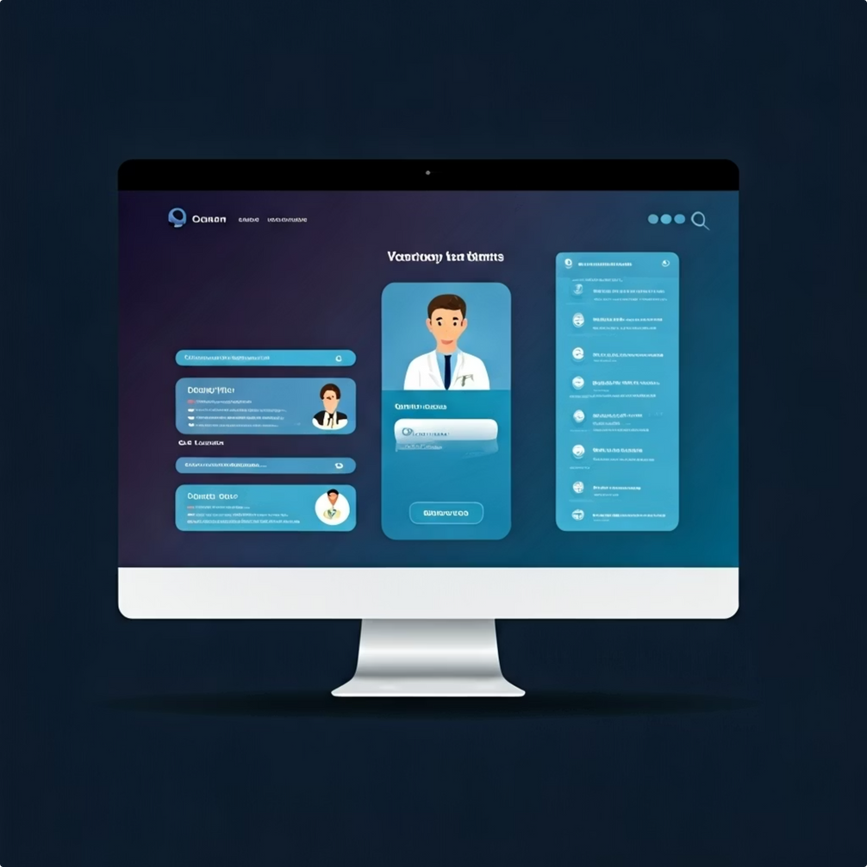
Goals/Objective
Develop a user-friendly web platform for online consultations.
Allow patients to search for doctors based on specialization and availability.
Enable secure appointment booking and chat-based consultation.
Provide doctors with features to manage schedules and issue digital prescriptions.
Allow administrators to manage users and monitor activities.

Slide 6
Features
24/7 Availability
Reduces Waiting Time
Faster Response from Specialist Doctors
Easy Appointment Booking
Secure And Confidential Communication
No Disruption to Daily Routine
Comfort And Convenience
Hygienic and safe
Saves Travelling Time/Costs

Slide 7
H/W Requirements & S/W Requirements
Hardware Requirements:
Software Requirements:
Processor: Intel i3 or higher
Operating System: Windows 10
RAM: 4 GB minimum
Backend: .NET
Frontend: React.js
Database: SQL Express
Tools: Visual Studio ,VS Code, GitHub

Slide 8





Patient Workflow
Patient Login
Patient Search for Doctor
Patient Books Appointment
Patient Will Consult with Doctor
Patient Gets Prescription

Slide 9



Doctor Workflow
Doctor Login
Doctor Checks Appointment and Attends Appointment
Doctor Prescribes

Slide 10
Admin Workflow
Login
Overlook

Slide 11
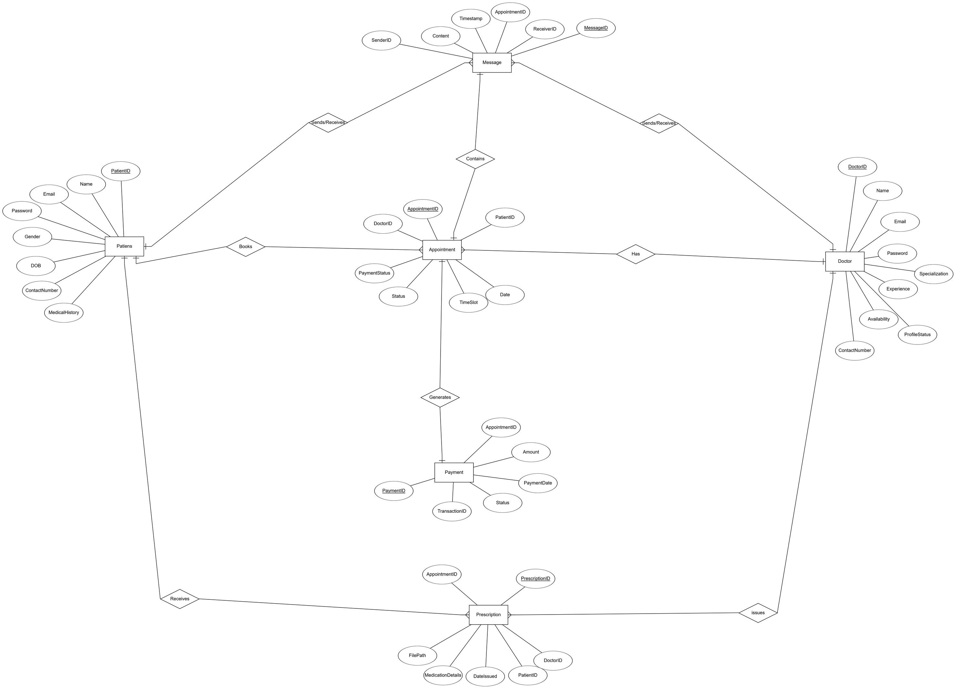
Entity-Relationship Diagram (ERD)

Slide 12
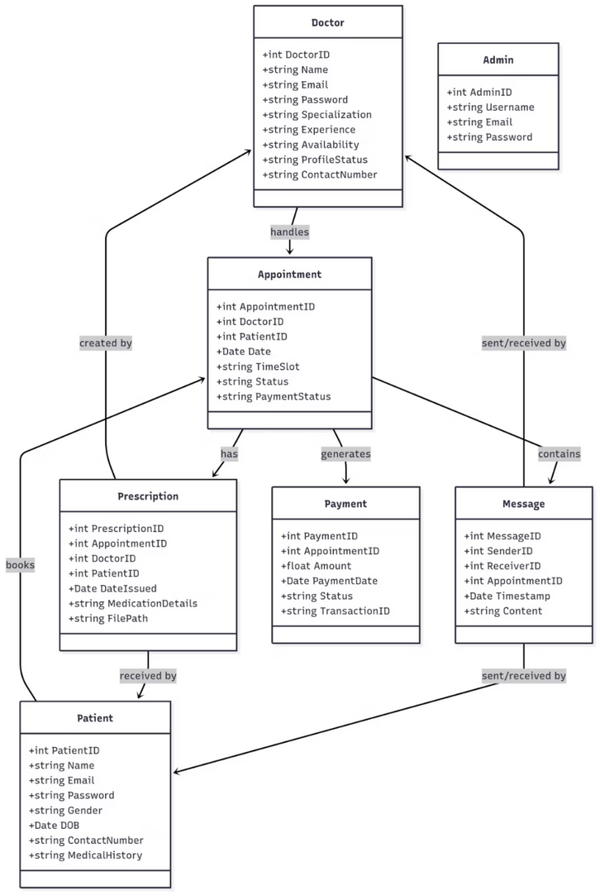
Class Diagram

Slide 13
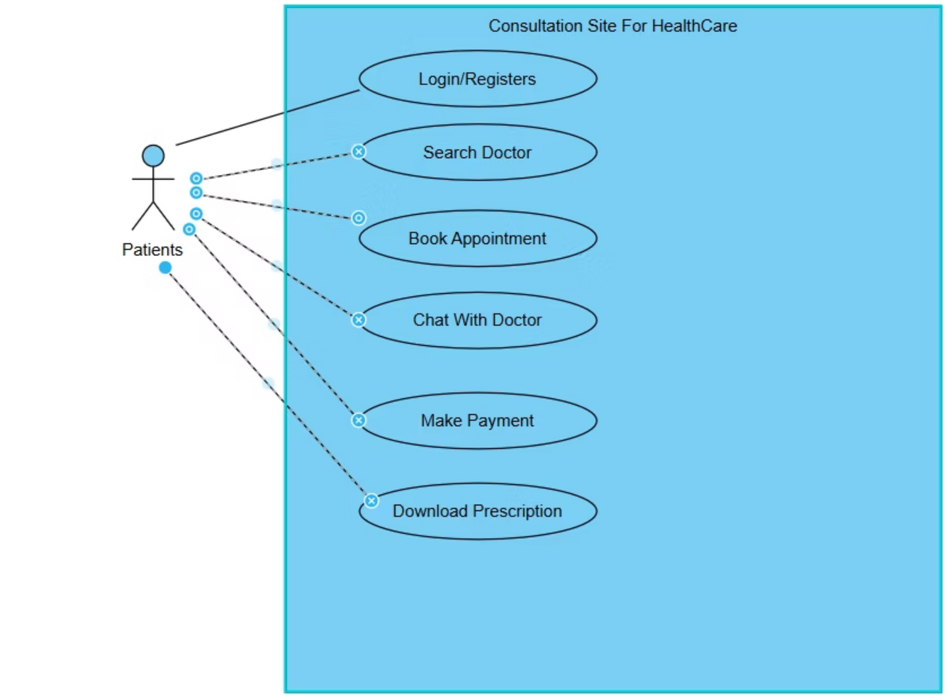
Use Case Diagram - Patient

Slide 14
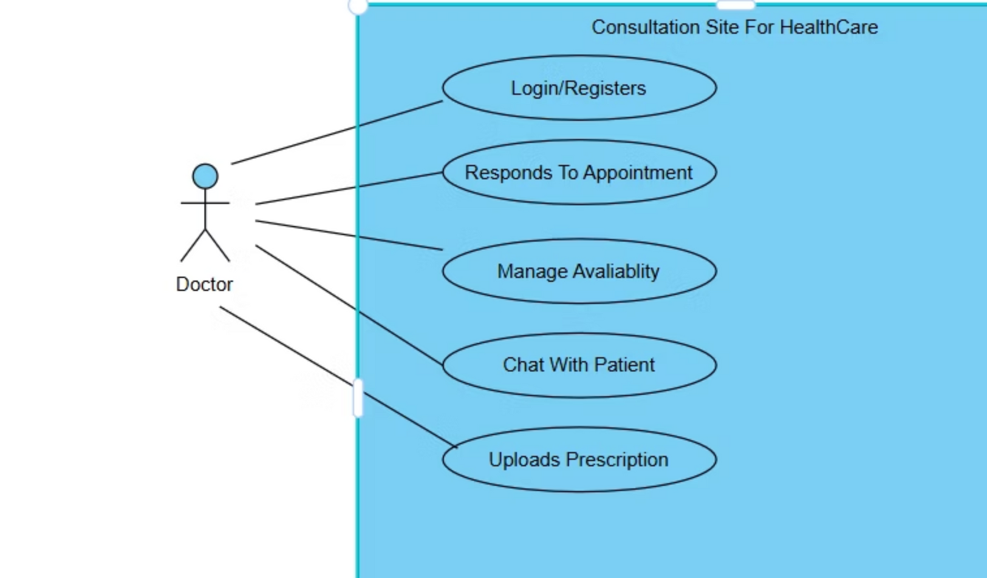
Use Case Diagram - Doctor

Slide 15
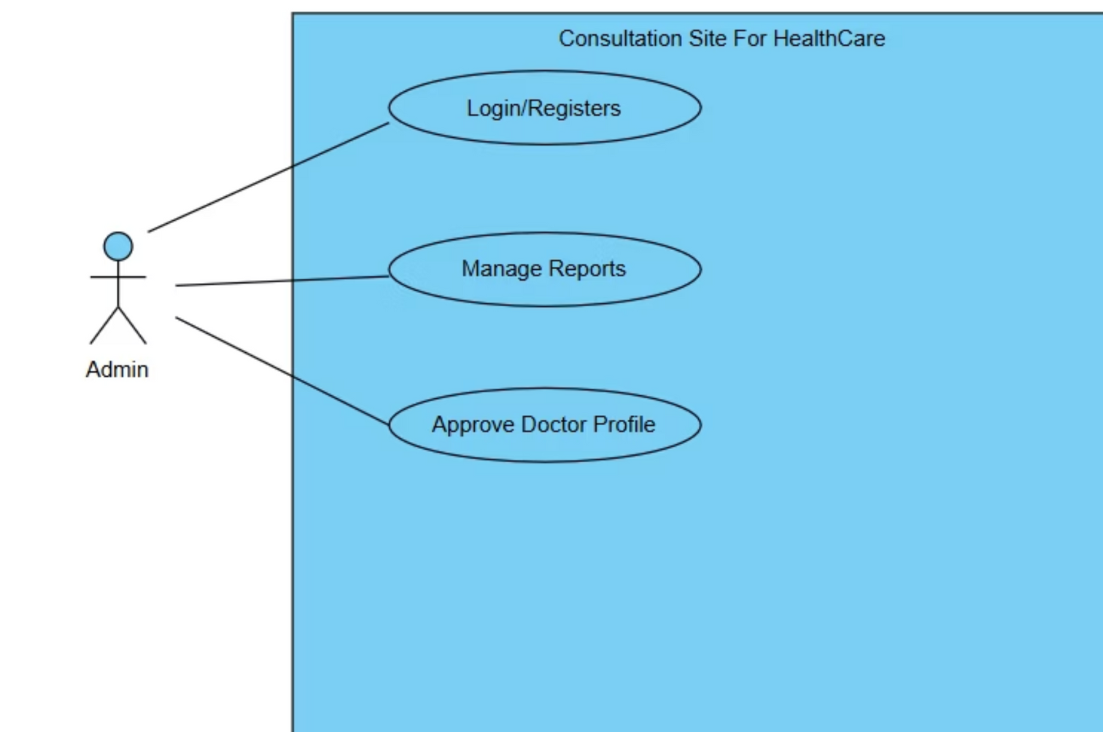
Use Case Diagram - Admin

Slide 16
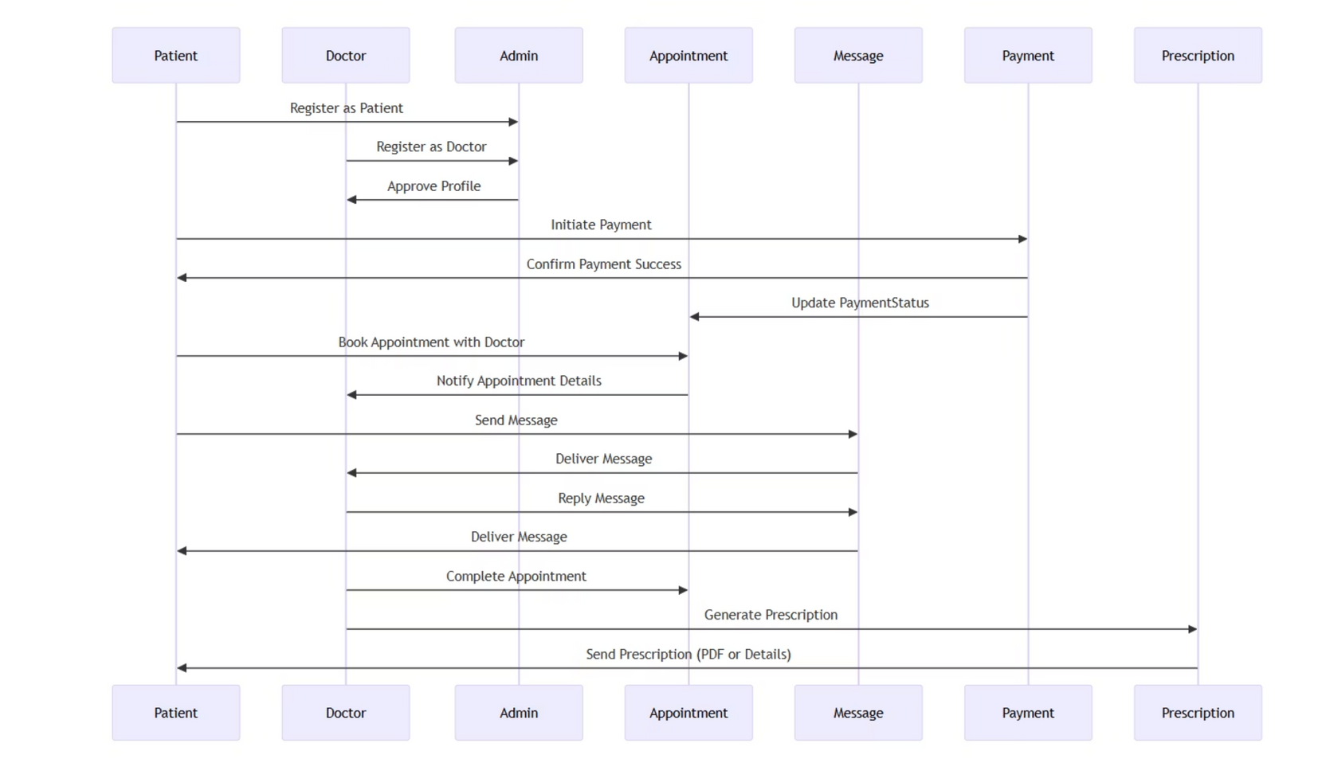
Sequence Diagram

Slide 17
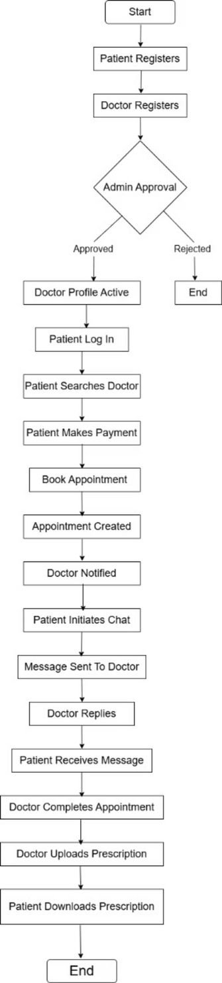
Activity Diagram

Slide 18

Thank You

